Slide 1
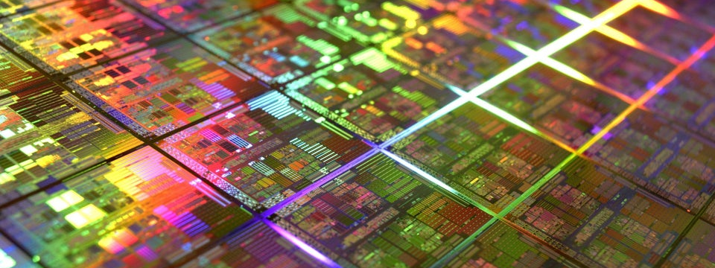
Slide Deck 12
ECE 4203 VLSI Design

Slide 2
Outline
Sequencing
Sequencing Element Design
Max and Min-Delay
Clock Skew
Time Borrowing
Two-Phase Clocking

Slide 3
Sequencing
Combinational logic
output depends on current inputs
Sequential logic
output depends on current and previous inputs
Requires separating previous, current, future
Called state or tokens
Ex: FSM, pipeline

Slide 4
Sequencing Cont.
If tokens moved through pipeline at constant speed, no sequencing elements would be necessary
Ex: fiber-optic cable
Light pulses (tokens) are sent down cable
Next pulse sent before first reaches end of cable
No need for hardware to separate pulses
But dispersion sets min time between pulses
This is called wave pipelining in circuits
In most circuits, dispersion is high
Delay fast tokens so they don’t catch slow ones.

Slide 5
Sequencing Overhead
Use flip-flops to delay fast tokens so they move through exactly one stage each cycle.
Inevitably adds some delay to the slow tokens
Makes circuit slower than just the logic delay
Called sequencing overhead
Some people call this clocking overhead
But it applies to asynchronous circuits too
Inevitable side effect of maintaining sequence

Slide 6
Sequencing Elements
Latch: Level sensitive
a.k.a. transparent latch, D latch
Flip-flop: edge triggered
A.k.a. master-slave flip-flop, D flip-flop, D register
Timing Diagrams
Transparent
Opaque
Edge-trigger

Slide 7
Latch Design
Pass Transistor Latch
Pros
+ Tiny
+ Low clock load
Cons
V_{t} drop
nonrestoring
backdriving
output noise sensitivity
dynamic
diffusion input
Used in 1970’s

Slide 8
Latch Design
Transmission gate
+ No V_{t} drop
- Requires inverted clock

Slide 9
Latch Design
Inverting buffer
+ Restoring
+ No backdriving
+ Fixes either
Output noise sensitivity
Or diffusion input
Inverted output

Slide 10
Latch Design
Tristate feedback
+ Static
Backdriving risk
Static latches are now essential
because of leakage

Slide 11
Latch Design
Buffered input
+ Fixes diffusion input
+ Noninverting

Slide 12
Latch Design
Buffered output
+ No backdriving
Widely used in standard cells
+ Very robust (most important)
Rather large
Rather slow (1.5 – 2 FO4 delays)
High clock loading

Slide 13
Latch Design
Datapath latch
+ smaller
+ faster
- unbuffered input

Slide 14
Flip-Flop Design
Flip-flop is built as pair of back-to-back latches

Slide 15
Enable
Enable: ignore clock when en = 0
Mux: increase latch D-Q delay
Clock Gating: increase en setup time, skew

Slide 16
Reset
Force output low when reset asserted
Synchronous vs. asynchronous

Slide 17
Set / Reset
Set forces output high when enabled
Flip-flop with asynchronous set and reset

Slide 18
Sequencing Methods
Flip-flops
2-Phase Latches
Pulsed Latches

Slide 19
Timing Diagrams
Contamination and Propagation Delays
t_{pd} | Logic Prop. Delay
t_{cd} | Logic Cont. Delay
t_{pcq} | Latch/Flop Clk->Q Prop. Delay
t_{ccq} | Latch/Flop Clk->Q Cont. Delay
t_{pdq} | Latch D->Q Prop. Delay
t_{cdq} | Latch D->Q Cont. Delay
t_{setup} | Latch/Flop Setup Time
t_{hold} | Latch/Flop Hold Time

Slide 20
Max-Delay: Flip-Flops

Slide 21
Max Delay: 2-Phase Latches

Slide 22
Max Delay: Pulsed Latches

Slide 23
Min-Delay: Flip-Flops

Slide 24
Min-Delay: 2-Phase Latches
Hold time reduced by nonoverlap
Paradox: hold applies twice each cycle, vs. only once for flops.
But a flop is made of two latches!

Slide 25
Min-Delay: Pulsed Latches
Hold time increased by pulse width

Slide 26
Time Borrowing
In a flop-based system:
Data launches on one rising edge
Must setup before next rising edge
If it arrives late, system fails
If it arrives early, time is wasted
Flops have hard edges
In a latch-based system
Data can pass through latch while transparent
Long cycle of logic can borrow time into next
As long as each loop completes in one cycle

Slide 27
Time Borrowing Example

Slide 28
How Much Borrowing?
2-Phase Latches
Pulsed Latches

Slide 29
Clock Skew
We have assumed zero clock skew
Clocks really have uncertainty in arrival time
Decreases maximum propagation delay
Increases minimum contamination delay
Decreases time borrowing

Slide 30
Skew: Flip-Flops

Slide 31
Skew: Latches
2-Phase Latches
Pulsed Latches

Slide 32
Two-Phase Clocking
If setup times are violated, reduce clock speed
If hold times are violated, chip fails at any speed
In this class, working chips are most important
No tools to analyze clock skew
An easy way to guarantee hold times is to use 2-phase latches with big nonoverlap times
Call these clocks φ₁, φ₂ (ph1, ph2)

Slide 33
Safe Flip-Flop
Past years used flip-flop with nonoverlapping clocks
Slow – nonoverlap adds to setup time
But no hold times
In industry, use a better timing analyzer
Add buffers to slow signals if hold time is at risk

Slide 34
Adaptive Sequencing
Designers include timing margin
Voltage
Temperature
Process variation
Data dependency
Tool inaccuracies
Alternative: run faster and check for near failures
Idea introduced as “Razor”
Increase frequency until at the verge of error
Can reduce cycle time by ~30%

Slide 35
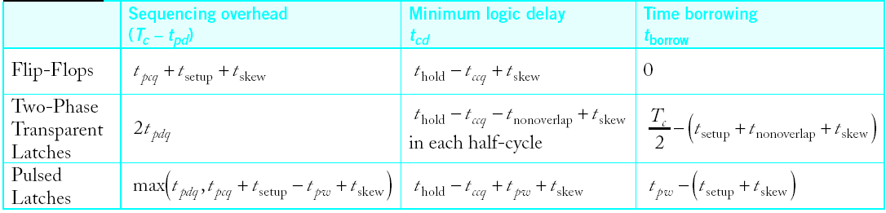
Summary
Flip-Flops:
Very easy to use, supported by all tools
2-Phase Transparent Latches:
Lots of skew tolerance and time borrowing
Pulsed Latches:
Fast, some skew tol & borrow, hold time risk

